Slide 1




SITE INTIATION VISIT

Slide 2
PROHIBIT-ICH TEAM
Chief Investigator | Professor David Werring d.werring@ucl.ac.uk
Co-Chief Investigator | Professor Peter Rothwell peter.rothwell@ndcn.ox.ac.uk
Trial Coordinator | Shahena Butt shahena.butt@ucl.ac.uk Tel: 0203 108 6181
BP Clinical Research Therapist: (BP Monitoring Centre) | Michelle Wilson michelle.wilson@ndcn.ox.ac.uk Tel: 01865 231601
BP Research Coordinator: (BP Monitoring Centre) | Louise Silver louise.silver@ndcn.ox.ac.uk Tel: 01865 234622
BP Clinical Research Fellow: (BP Monitoring Centre) | Iain McGurgan ian.mcgurgan@ndcn.ox.ac.uk Tel: 01865 231601

Slide 3

List of Sites
Principal Investigator | Site
Professor David Werring | University College Hospital, London
Professor Peter Rothwell | John Radcliffe Hospital, Oxford
Dr Soma Banerjee | Charing Cross Hospital, London
Professor Rustam Al-Shahi Salman | Royal Infirmary of Edinburgh
Dr Adrian Parry-Jones | Salford Royal Hospital, Manchester
Prof Hedley Emsley | Royal Preston Hospital
Dr Dulka Manawadu | Kings College Hospital, London
Dr Niamh Hannon | Addenbrooke's Hospital, Cambridge
Dr Kailash Krishnan | Nottingham University Hospitals NHS Trust
Dr Keith Muir | Queen Elizabeth University Hospital, Glasgow
Dr Liqun Zhang | St George’s Hospital, London
Dr Kirsty Harkness | Sheffield Teaching Hospitals NHS Foundation Trust

Slide 4
AGENDA
Introduction to the Study and Scientific Background
Study protocol
  Objectives
  Primary and secondary outcomes
  Inclusion and exclusion criteria
Trial Co-ordination from Oxford
  Blood Pressure Device
  Prescription Change
Trial Co-ordination from UCL
  Clinical Data collection/Follow-up
  Questionnaires and assessments
  MRI Protocol

Slide 5
Introduction to the Study and Scientific Background

Slide 6

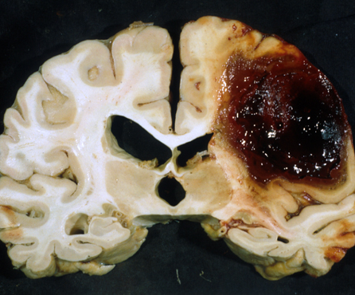
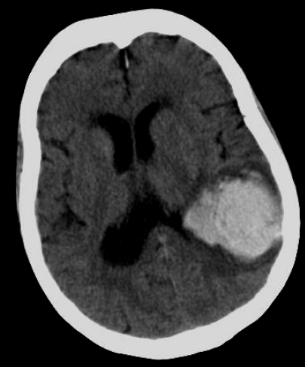
Importance of intracerebral haemorrhage
About 10-20% of all strokes worldwide¹
Median 1 month case fatality 40%²
~ 60%-90% of survivors survivors are dependent²
Case fatality not improved 1980-2006²
Incidence not declining in elderly populations despite better BP control³
  especially antithrombotic related
  ? related to CAA
Few effective treatments
Lancet Neurol 2009;8:355-69
Lancet Neurol 2010;9:167-76
Lancet Neurol. 2007;6:487-93

Slide 7
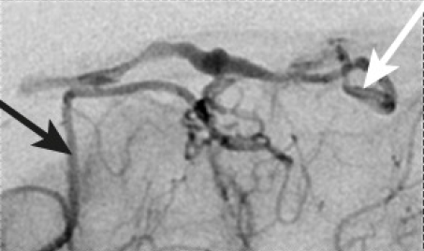
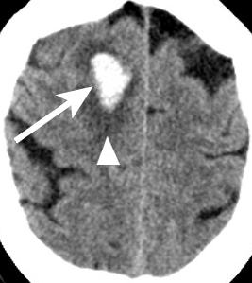
Causes of spontaneous ICH
“primary” ~80%
Hypertensive arteriopathy
Cerebral amyloid angiopathy
Arteriovenous malformation
Aneurysm
Cavernoma
AV fistula
Venous sinus thrombosis
Clotting problems
Tumour
RCVS
Vasculitis
Endocarditis
other causes ~20%
Arteriovenous malformation
“macrovascular”
AVM
Also see SMASH-U (Structural lesion, Medication, Amyloid angiopathy, Systemic/other disease, Hypertension, Undetermined) for one suggested ICH classification scheme Stroke. 2012;43:2592-2597

Slide 8
A definition of cerebral small vessel disease
A group of pathologies affecting small perforating cerebral arterioles, capillaries (and venules), associated with a characteristic spectrum of clinical and imaging findings
Lancet Neurol. 2013 Aug;12(8):822-38.

Slide 9
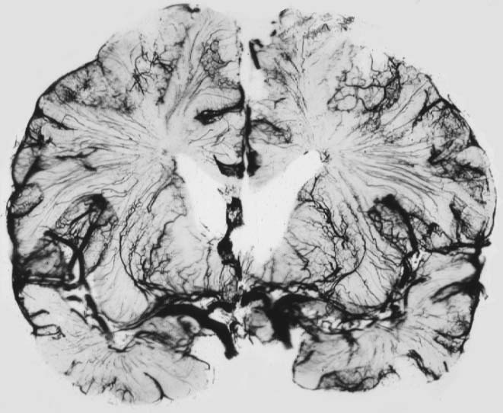
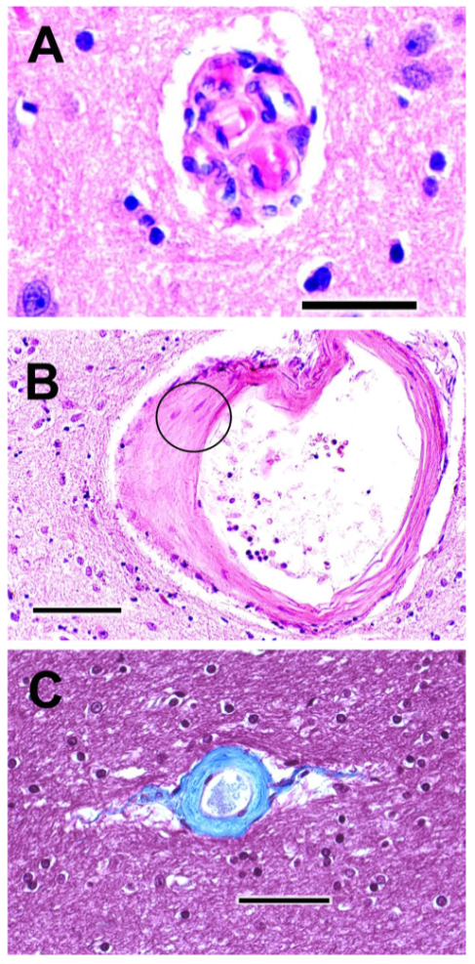
small vessel networks
of the brain
CAA
cortical-leptomeningeal arterioles and arteries
deep perforators (white matter)
deep perforators (basal ganglia)
Arteriolosclerosis
Salamon, 1973

Slide 10
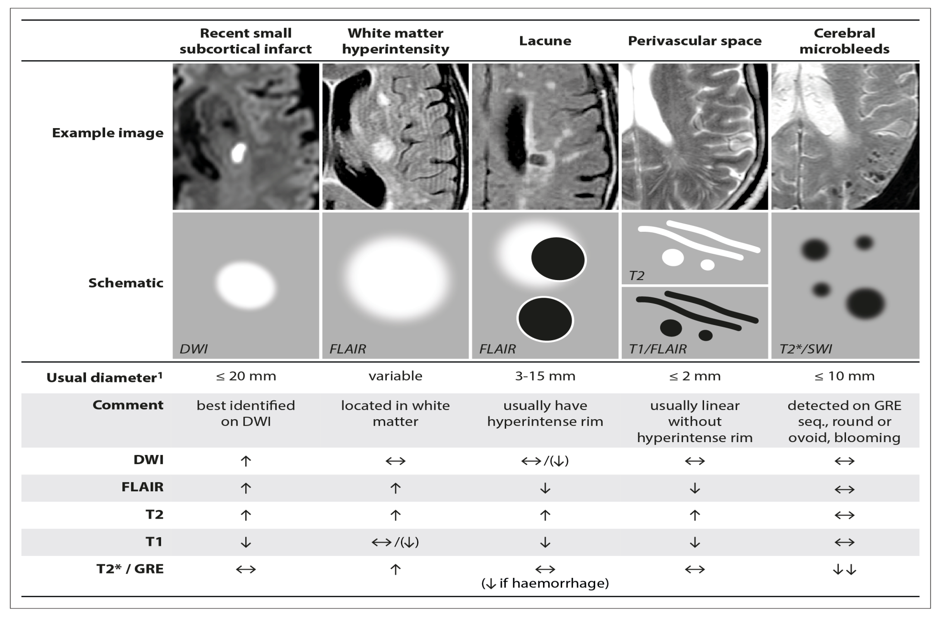
STRIVE: Standards for Reporting and Imaging of Small Vessel Disease
Lancet Neurol. 2013 Aug;12(8):822-38.

Slide 11
Why use an SVD imaging biomarker?
Can classify the underlying SVD causing ICH
Reflect brain injury relevant to the adverse consequences of SVD, including cognitive impairment
Evolve over time so can monitor progression
A surrogate outcome marker is attractive for a clinical trial, because it may be possible to assess beneficial or hazardous effects of an intervention in a much small number of participants in comparison to clinical event outcomes (e.g. recurrent stroke).

Slide 12
The ideal biomarker for clinical studies
Clinically meaningful
Closely representative of the disease’s underlying biological progression
Efficient at detecting changes in response to treatment
Reliably and reproducibly measurable
Easily generalisable across many trial sites.
Greenberg et al, Lancet Neurology 2014

Slide 13
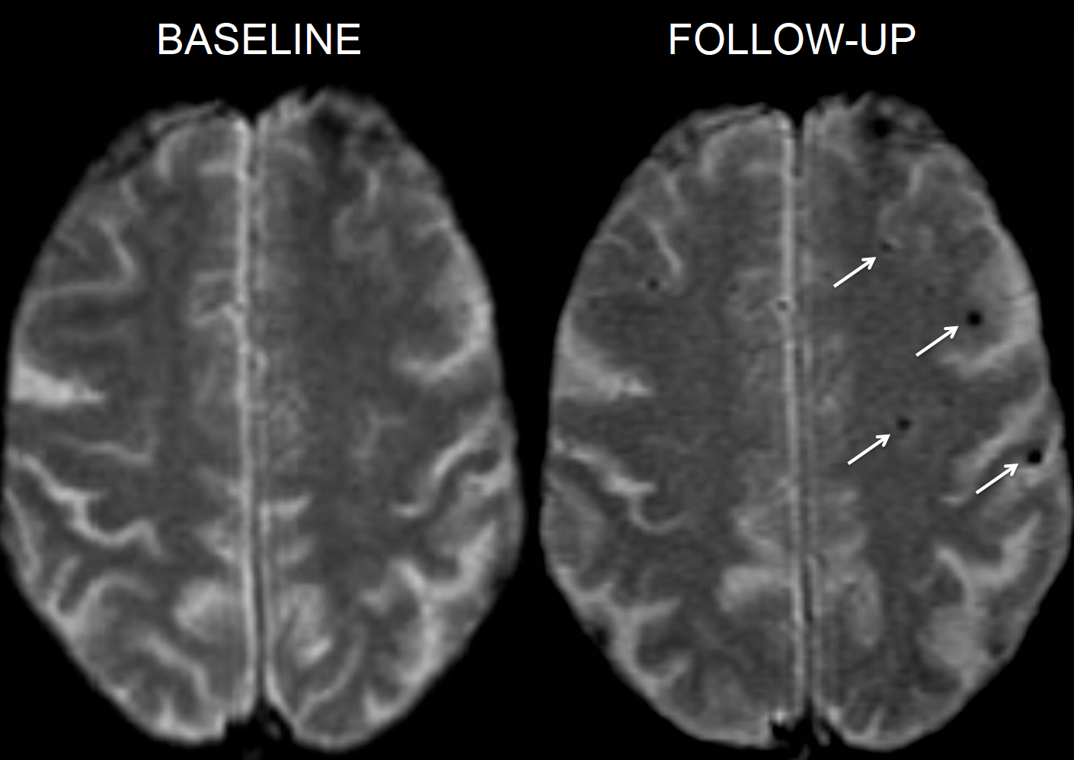
Cerebral microbleeds
The development of new CMBs was strongly related to baseline systolic BP (OR 1.28 per unit increase, 95%CI 1.23-1.33, p<0.001).
Stroke. 2010 Jan;41(1):184-6.

Slide 14
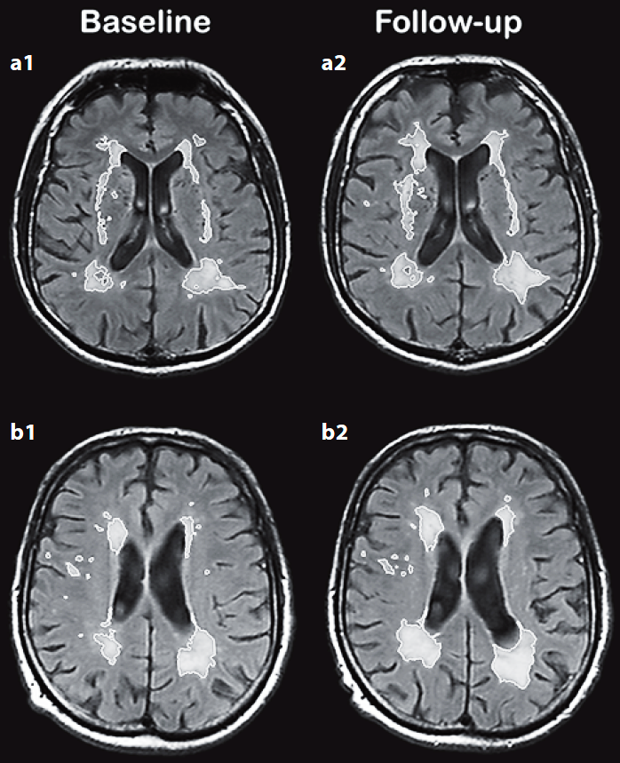
White matter hyperintensities
Cerebrovasc Dis 2008;25:247–253

Slide 15
WMH volume increases over time
Shown in older community and hospital stroke populations
26 patients (mean age 69.1) with probable or possible Cerebral Amyloid Angiopathy scanned over ~1yr found median WMH growth of 0.5 mL per year (IQR 0.1-2.8 mL per year)
192 participants in the PROGRESS trial mean total new WMH volume was significantly reduced in the active treatment group (0.4 mm3 [SE=0.8]) compared with placebo group (2.0 mm³ [SE=0.7]; P=0.012)
With 56 patients in each arm we can detect a similar difference in new WMH lesion volume (2.0mm³ vs 0.4mm³) (if the SD does not exceed 2.0 mm³) to that shown overall in PROGRESS, with power 80% at ⍺ significance level of P=0.05.
References
Stroke. 2008;39(5):1414-20.
Stroke 2008;39(10):2712-9.
Lancet. 2003;361(9374):2046-8.
Neurology. 1999;53(1):132-9.
Trials. 2017;18(1):78.
Neurology. 2006;67(1):83-7.
Circulation. 2005;112(11):1644-50.

Slide 16
Blood pressure in acute stroke
Oxford Vascular Study
Acute
Previous
Previous
Acute
Lancet Neurol 2014; 13: 374-84

Slide 17



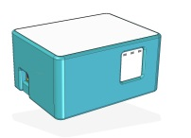
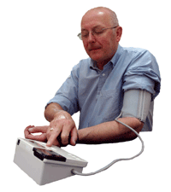
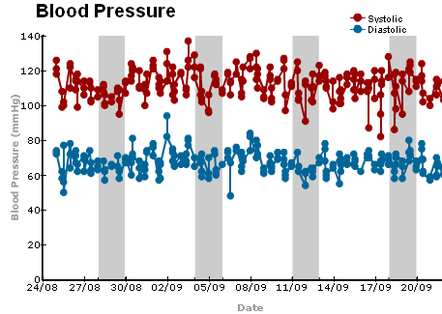
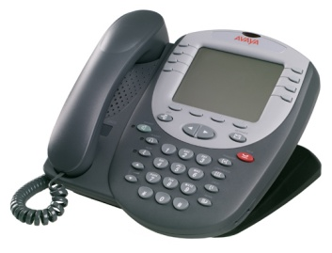
Telemetric Bluetooth Home Monitoring
Notes:
Patient: First TIA or stroke
Over 18, no upper age limit
Consent / Assent
Able to attempt home BP monitoring themselves or with help
BP taken and treatment started at clinic
Equipment: Receive Bluetooth monitor
Appropriate cuff
Information sheet / training
BP taken once in each arm
Non-dominant arm used unless ≥20mmHg difference in systolic between arms Contraindication e.g. Reduced sensation
Protocol: Patients asked to measure BP
x3 in 10 minutes, 3 times a day:
Set 1: after wakening (usually before anti-hypertensives taken)
Set 2: mid morning –10 am if possible
Set 3: Just before bed
To take readings
After rest
Sitting at a table if possible
Be quiet and still
Using same arm each time
BPs checked each working day
Telephone patient if readings Absent - Was BP measured? Any technical problems?
High - Can they account for them?
BPs above 130/80 mmHg treated unless contraindications e.g. posterior circulation stenosis
Anti-hypertensives changed by: Phoning patient to increase dose of current medication
Sending prescription for a new medication
Making recommendations to GP
BP’s discussed with a hypertension specialist if required
Patients asked to use Bluetooth for 1 month or until BP control optimized
Then use standard BP monitor to maintain control Weekly until 1 year
Monthly until 2 years
Patients reviewed
In hospital, home, by telephone
1, 3, 6, 12 and 60 months (as part of OXVASC)
2 BPs taken routinely each time
Ambulatory BP monitoring at 1 and 12 months (in same arm as bluetooth)
Check for admissions, recurrent events, changes in medications, blood tests etc.

Slide 18
COMMIT Study – OXVASC home monitoring
1200 patients; 2886 drug changes; 92% uptake

Slide 19
Conclusions
Telemetric home BP monitoring is feasible and well tolerated by patients with TIA and non-disabling stroke, irrespective of age, and is found to be helpful by GPs
Monitoring detects high levels of masked hypertension, and informs titration of medication in the majority of patients
Monitoring is associated with good BP-control and excellent longer-term compliance with medication
Intensive BP-lowering titrated according to HBPM is reasonably safe in an elderly population prone to falls
Residual hypertension detected on home-monitoring is of more prognostic value than on ABPM
BUT - can it be rolled out across multiple centres?

Slide 20
Study Protocol

Slide 21
Study Objectives
Primary Objectives
i). BP study:
Does the use of centralised telemetric home BP monitoring in patients with spontaneous (non-traumatic) ICH achieve a reduction in 3-month BP compared with standard care?
ii). Imaging study:
Does intensive BP treatment using centralised telemetric home monitoring result in a reduction in progression of SVD-related brain injury assessed on MRI compared with standard care?
Including, but not limited to:
- White matter hyperintensities (WMH),
- White matter structural integrity,
- Incident cerebral microbleeds (CMBs),
- Brain atrophy

Slide 22
Study Objectives
Secondary Objectives
i). BP study:
Is it feasible in a multi-site setting?
Is it safe to intensively lower BP for an extended period of time following spontaneous ICH?
Is the intervention acceptable to participants?
ii). Imaging study:
Does any reduction in recurrent vascular events (including ICH) or progression of cognitive decline on intensive BP treatment correlate with baseline measures of changes in quantitative and structural brain scan markers of small blood vessel health?
Are there any adverse effects on neuroimaging measures (e.g. increased white matter ischaemic injury) associated with intensive BP treatment?

Slide 23
Study Outcomes
Primary Outcomes
i). BP study:
Efficacy: the magnitude of difference in BP at 3 months in the intervention arm versus control arm
Feasibility: consent rate; dropout rate from the intervention prior to 1 month; patient approval of the monitoring process
Safety: serious adverse events related to reducing BP in intervention arm
ii). Imaging study
Efficacy: the progression in MRI white matter hyperintensity (WMH) volume over 1 year

Slide 24
Study Outcomes
Secondary Outcomes
i). BP study:
Clinical outcomes including recurrent vascular events and cognition; number of BP lowering drugs at 3 months and at 1 year follow-up visits; mean daytime BP at 1 year on 24-hour ABPM
ii). Imaging study:
Neuroimaging outcomes including (but not limited to)
the proportion of patients who develop new cerebral microbleeds (CMBs) over 1 year
number of new CMBs at 1 year
new infarcts or intracerebral haemorrhages at 1 year change in mean diffusivity (MD), fractional anisotropy (FA) and other 3T DTI metrics
change in cerebral blood flow (CBF) on 3T PCASL
change in total brain volume, white matter volume and grey matter volume on 3T T1 volumetric images
composite neuroimaging measures (e.g summary SVD scores)

Slide 25
Recruitment
Eligible patients will be identified by clinical staff from acute stroke units or high dependency units at participating hospitals, outpatient clinics (stroke, neurology, geriatric, neurosurgical) and from primary care centres
Potentially eligible participants will be handed an information leaflet and a letter of invitation
Patients will have at least 24 hours to consider the information before being telephoned or approached by a member of research/clinical team at the NHS site to see if they are interested in taking part in the trial
If they are, a convenient time will be arranged for them to meet a research staff member delegated by the CI to discuss the study, go through the information sheet, assess eligibility and answer any questions they may have

Slide 26
Inclusion Criteria
Adults (≥40 years) with spontaneous primary ICH
BP control since the ICH is deemed not adequate AND the measured SBP prior to randomisation is ≥130 mm Hg
Recruitment soon after ICH in encouraged
Plan for home discharge (not to a nursing or care home)
Can undertake home BP measurements
Can complete an MRI scan
Can attend and complete the study assessments including cognitive screen
Can provide informed consent (or suitable consultee available)

Slide 27
Exclusion Criteria
Inability to provide informed consent and lack of suitable consultee
Evidence of a macrovascular or structural cause for ICH (e.g. AVM or tumour)
Diagnosis of dementia
Low Functional status (MRS ≥4) before or after ICH
Life expectancy <2 years
Taking more than 3 or more BP-lowering medications
Consistently good BP control (below 130/80 mm Hg), judged not to require more intensive treatment
Flow-restricting intracranial/extracranial large arterial stenosis
Contraindication to MRI
Absence of mobile phone coverage
Contra-indication to BP treatments (e.g. symptomatic postural hypotension) is not an absolute exclusion criterion, but more information must be provided
Note that participation in other CTIMP or device trial is NOT an automatic exclusion criterion

Slide 28

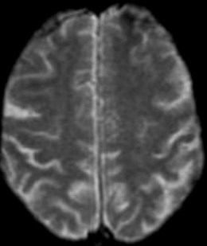
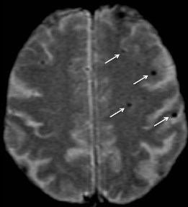
Basic trial structure
Baseline MRI
before randomisation
Follow-up MRI
at 12 months
ANALYSIS

Slide 29
Randomisation Procedure
Patients will be randomised in a 1:1 group assignment ratio to intensive BP lowering (intervention group) or standard care (control group) using an online randomisation service (Sealed Envelope)
Baseline data collected (as described later)

Slide 30
Blood Pressure Monitoring

Slide 31
BP Measurement at Baseline
3 BP measurements (2 seated and one standing after a minimum of 3 minutes)
The initial measurement should be taken in both arms; if there is a significant difference (>20 mm Hg systolic) between them then the arm with the higher value should be used for subsequent monitoring
Baseline 24-hour ABPM will be fitted and recorded in all participants

Slide 32
Telemetric Home BP Monitor

Slide 33
BP Treatment/Prescription changes
The Oxford centre will directly advise patients on starting or adjusting BP medication
1st line treatment will usually be either combination therapy with perindopril and indapamide, or amlodipine 5mg daily
Subsequent options will be likely to include the addition of spironolactone, an alpha-blocker and/or a beta-blocker
The Oxford BP team will contact the patient directly to advise them on medication changes
Changes will be notified to the GP and local research team
The GP will provide prescriptions to patients

Slide 34
BP Target
<120/80 mm Hg
If this is consistently achieved, monitors will be collected after a minimum of 1 month
We expect most will be controlled by 3 months
3 month 24-hour ABPM
Conventional monitors will be issued (weekly readings)

Slide 35
Trial Coordination from UCL
^{Shahena Butt}

Slide 36
Coordination of PROHIBIT-ICH
^{Clinical data collection}
^{Follow-up}
^{Questionnaires/Assessments}
^{MRI imaging}
MRI imaging upload and transfer

Slide 37

Clinical Data Collection: eCRF
^{Data collection}
^{Baseline}
^{3 month follow-up}
^{12 month follow-up}

Slide 38
 | Screening | Intervention phase and Follow-ups
 | Baseline | 3 Month follow-up | 12 Month follow-up
Visit No: | 1 | 2 | Final Visit
Informed Consent | X
Medical History | X
Eligibility confirmation | X
Blood test | X
MRI Scan (before randomisation) | X |  | X
Blood Pressure | X | X | X
24-hour ABPM | X | X | X
Cognitive assessment | X | X | X
Quality of life assessment (EQ-5D) | X | X | X
BP acceptability questionnaire |  | X
Randomisation | X

Slide 39
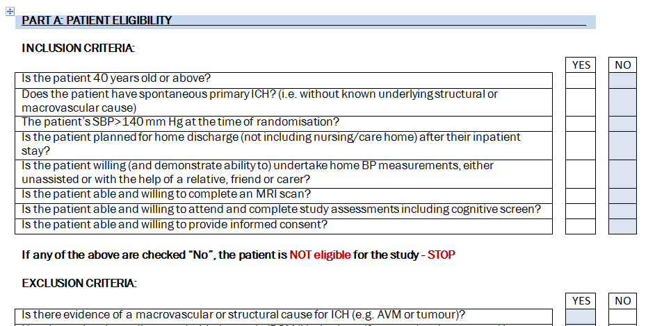
Clinical Data Collection: eCRF
^{Data collection}
  Electronically on sealed envelope
  ^{Secure, authorised access}

Slide 40
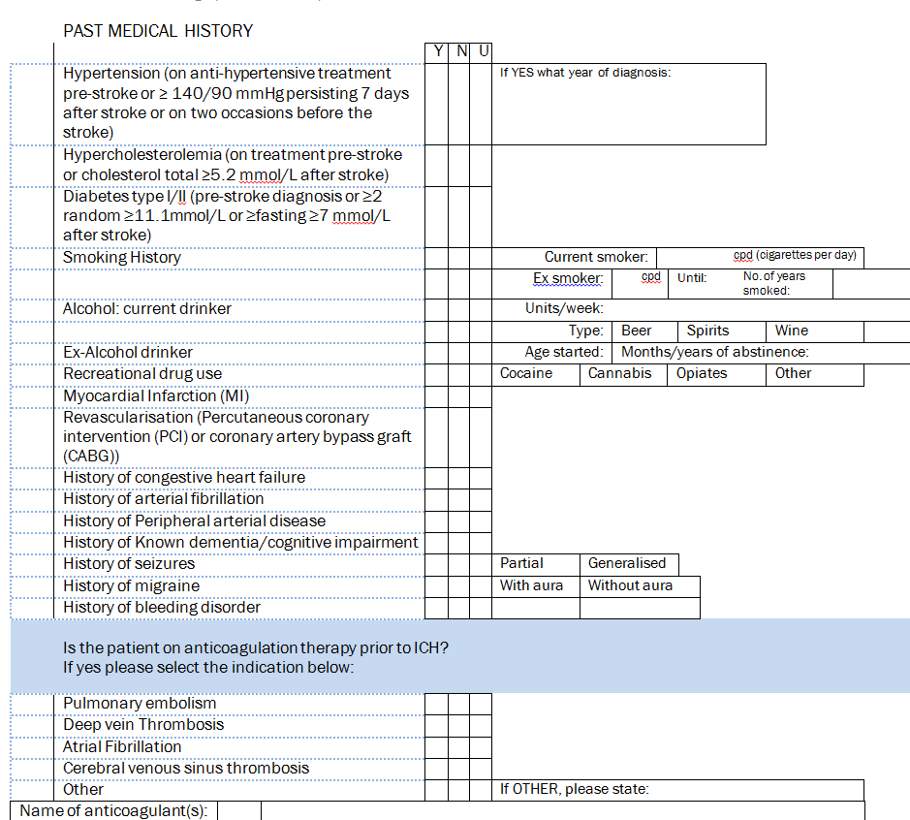
Clinical Data Collection: eCRF
^{Baseline}
^{Medical history}
^{Blood pressure medication}
^{3 BP measurements}
^{24-hour ABPM}
^{Blood test (venepuncture)}
MRI brain scan - performed prior to randomisation.
Cognitive functional assessment (modified Montreal Cognitive Assessment)
Completion of the EQ-5D questionnaire

Slide 41
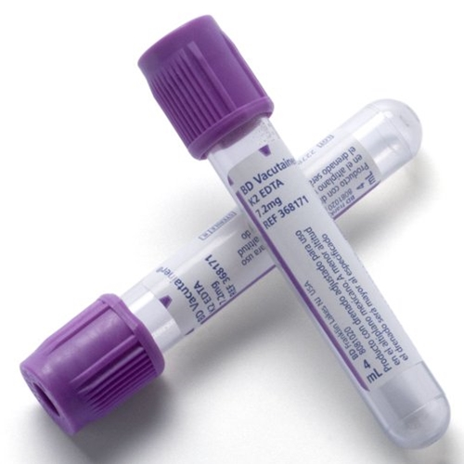
Blood Sample - Baseline
About 5-10mls Blood will be taken from consenting patients
EDTA blood sampling tube
Stored at UCL Institute of Neurology, Queen Square for future genetic research.
Sent in a Safebox from the sites to Shahena
Royal Mail Safe Boxes will be provided

Slide 42

Clinical Data Collection: eCRF
^{3 month follow-up}
        ^{3 month follow-up eCRF}
    ^{BP recorded}
    modified Montreal Cognitive assessment
    ^{EQ-5D questionnaire}
    home blood pressure acceptability questionnaire
    ^{24-hour ABPM}
^{12 month follow-up}
    ^{12 month follow-up eCRF}
    As Above (minus: home blood pressure acceptability questionnaire)
    ^{MRI Scan}

Slide 43
Questionnaires/Assessments
Cognitive Assessment
EQ-5D
  Standardised instrument for use as a measure of health outcome
  Two pages
  EQ-5D descriptive system
  EQ visual analogue scale

Slide 44
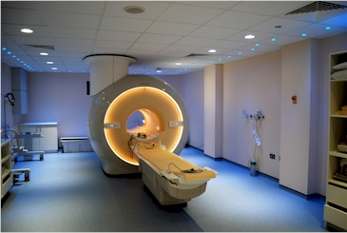
MRI
^{Outcomes}
^{MRI Protocol}
^{Sequences}
MRI imaging upload and transfer

Slide 45
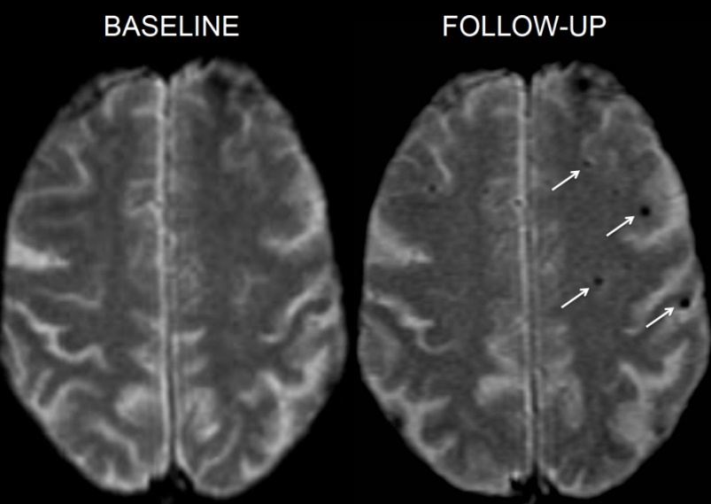
MRI
Outcomes
change in white matter hyperintensity volume
change in white matter microstructure (DTI)
change in the number of CMBs
change in cerebral atrophy

Slide 46
MRI
MRI Protocol and Manual
For major MRI scanner manufacturer (Siemens, GE Philips)
Manual: how to upload a scan

Slide 47
MRI protocol
Sequences
  3D T1
  3D FLAIR
  DTI (simplified)
  3D SWI
  Axial T2
      Optional: Arterial Spin labelling (5min)
                Total: 27min
(5min)
(5min)
(5min)
(5min)
(2min)
Total: 22min

Slide 48
MRI Image upload and transfer
Set- up: Password protected Log-in
  Name of person uploading the scans
  Email address
  Image file requirement:
  File needs to be compressed – Zip file

Slide 49
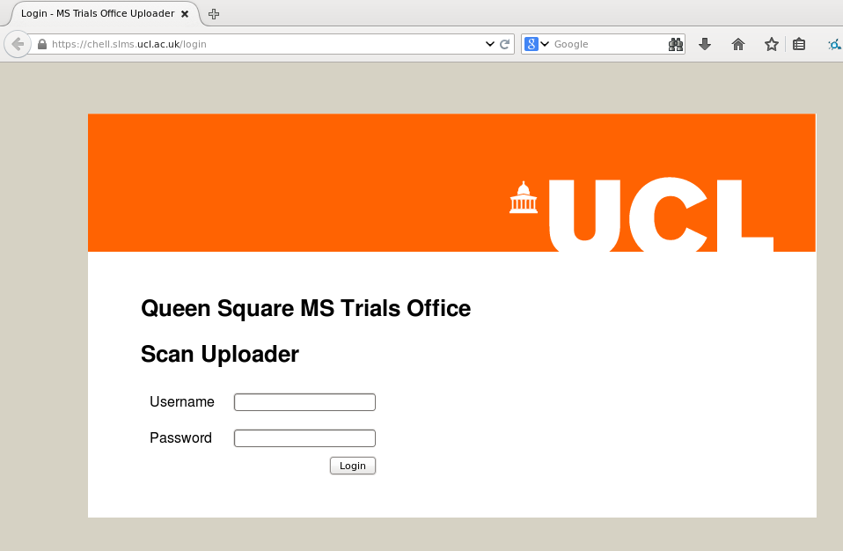
MRI Image upload and transfer
http://qsmscentre.org.uk

Slide 50
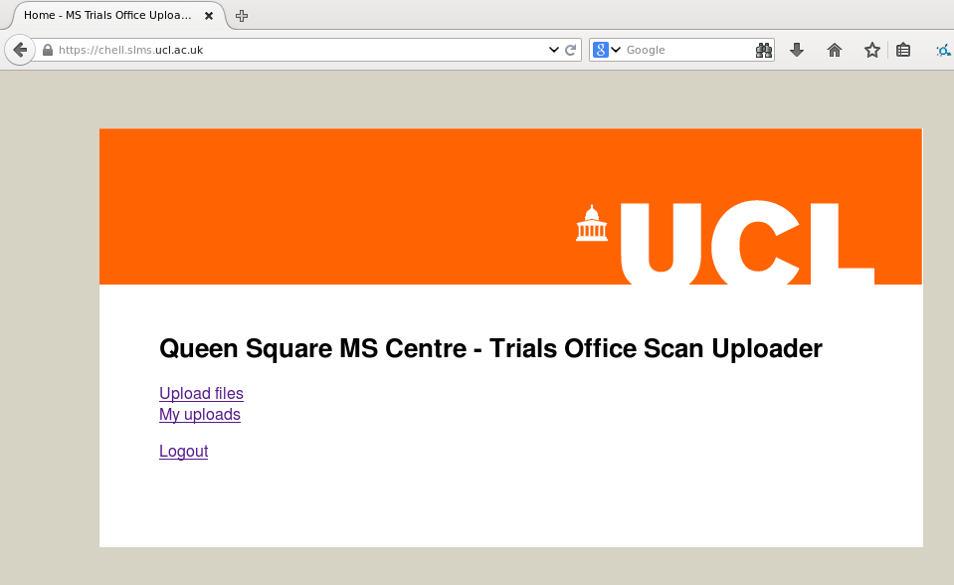
MRI Image upload and transfer

Slide 51
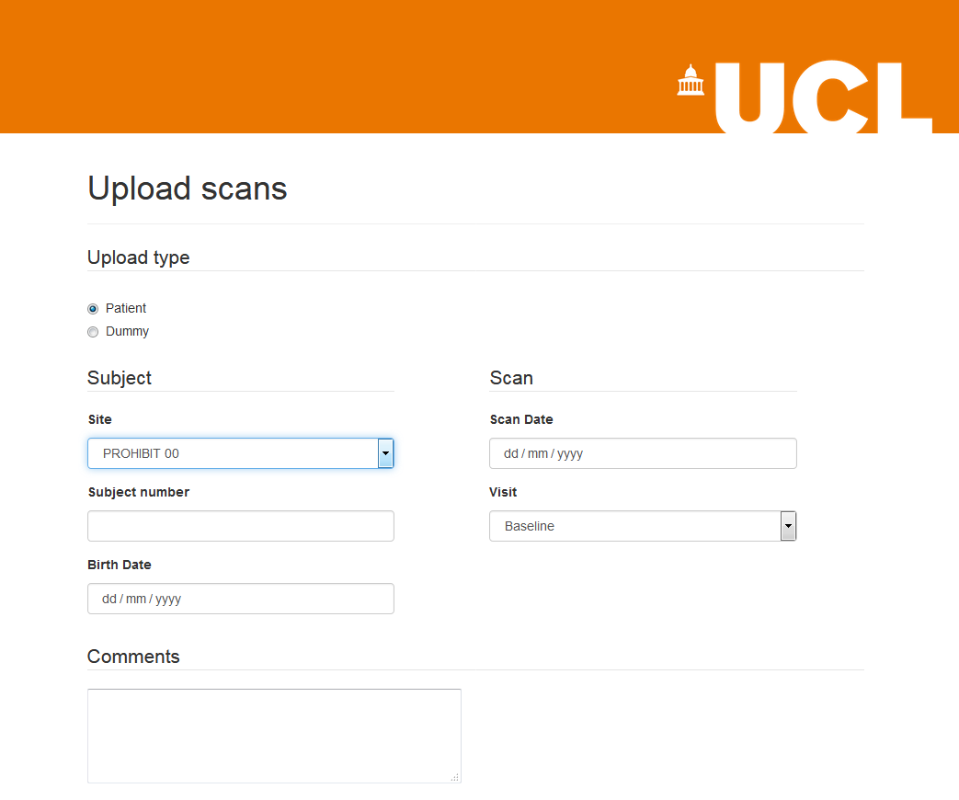
MRI Image upload and transfer

Slide 52
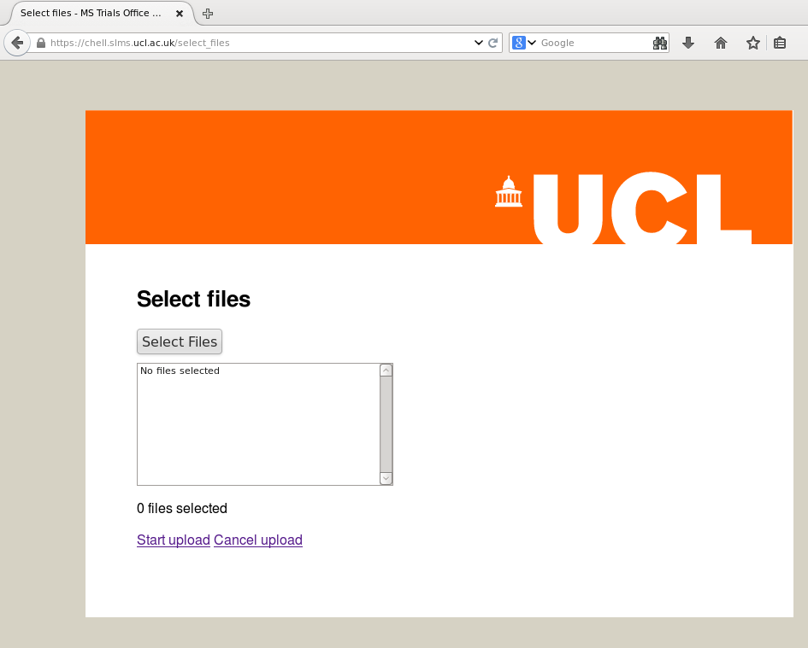
MRI Image upload and transfer
ZIP FILE

Slide 53
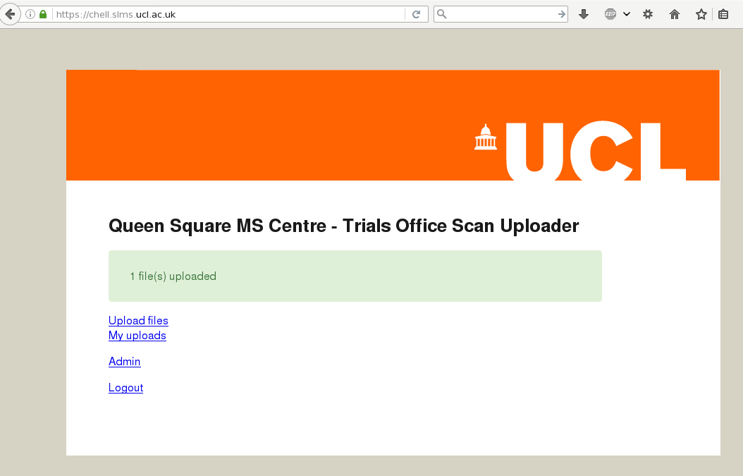
MRI Image upload and transfer

Slide 54
Where Are We?
Regulatory:
  Ethical Approval
  Final local R&D approval needed
Operational:
  Contact made with all sites
  Gathering local study documentation
  Creating local Site Files
Site Initiation:
    Study team

Slide 55

If All Is In Place…
LET’S GET STARTED!
Dissemination via email
All local study staff members will be included in the email
Co-ordinator will action

Slide 56
THANK YOU

